Slide 1
Small Intestine
-7m of length is the longest region of the alimentary tract
-anatomically in to three regions, duodenum, jejunum and ileum.
-it digests food material and absorbs end products of the digestive process..
-to perform its digestive functions, the first region of the small intestine, the duodenum, receives enzymes and alkaline buffer from the pancreas and bile from the liver, additionally, epithelial cells and glands of the mucosa contribute buffer and enzymes to facilitate digestion.

Slide 2
Modifications of the luminal surface:
The luminal surface of the small intestine is modified to increase its surface area, three types of modifications have been noted:
1-Plicae circulars (Valves of Kerckring), are transverse folds of the submucosa and mucosa that form semicircular to helical elevations. These are permanent fixtures of the duodenum and jejunum and end proximal half of the ileum, the increase the surface area by a factor of 2-3.
2- Villi, are epithelial covered, finger- like or oak leaf- like protrusions of the lamina propria. The core of each villus contains capillaries loops, lymphatic channels and few smooth muscle fibers, embedded in loose c.t and rich in lymphatic cells.

Slide 3
it are permanent structure, their numbers are greater duodenum than in the jejunum or the ileum. Villi increase surface area of the small intestine by a factor of 10.
3-Microvilli, modifications of the apical plasma lemma of the epithelial cells covering the intestinal Villi, increase the surface area of small intestine by a factor of 20.
Thus, the three types of intestinal surface modifications in crease the total surface area available of absorption of nutrients by a factor of 400-600.

Slide 4
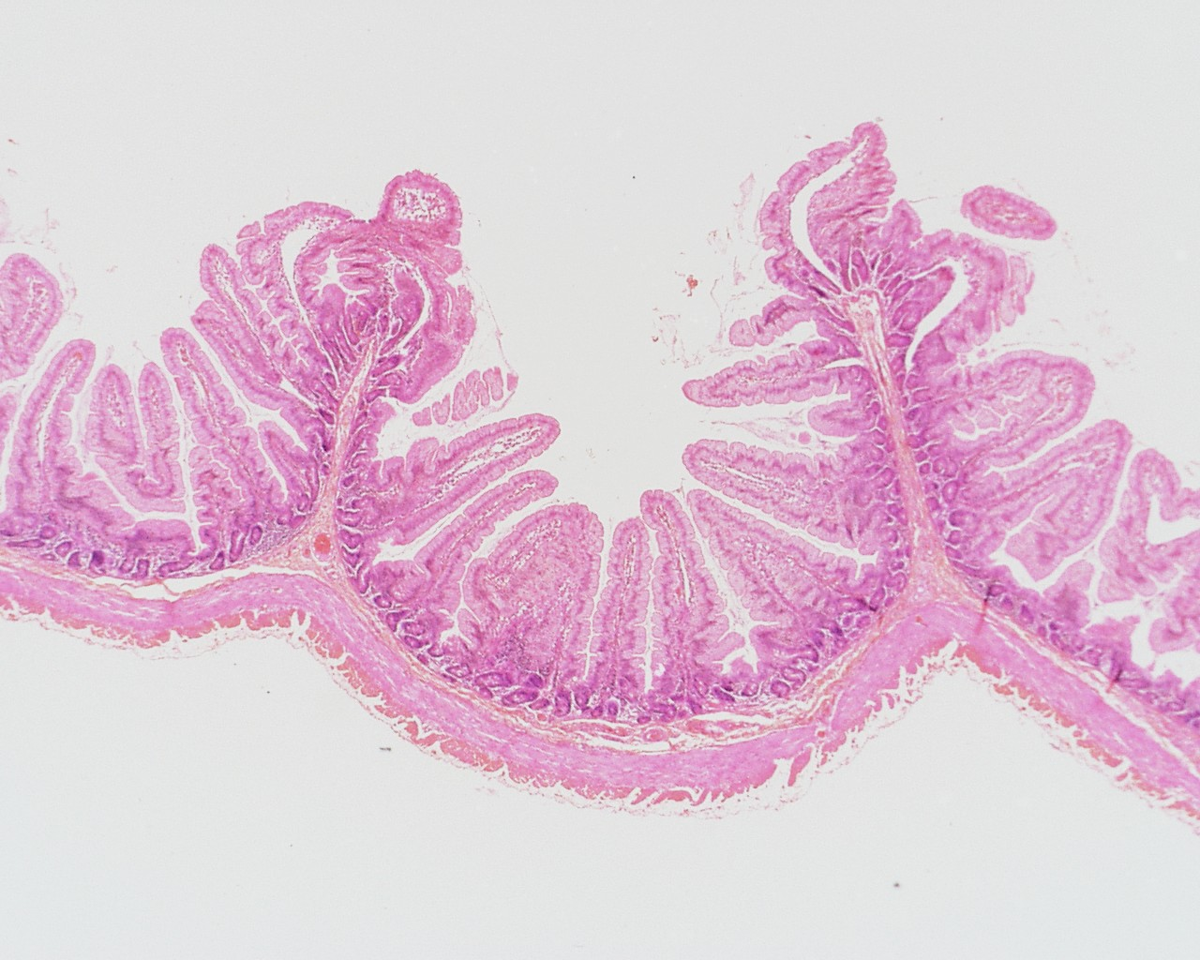
Scanning view of the Small Intestine demonstrating Plicae Circularis

Slide 5
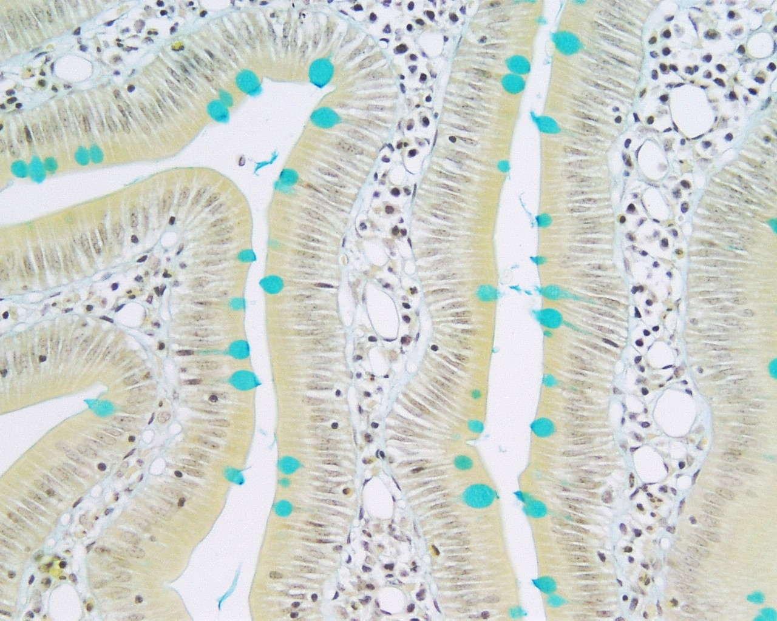
High Power View of Villi

